Slide 1
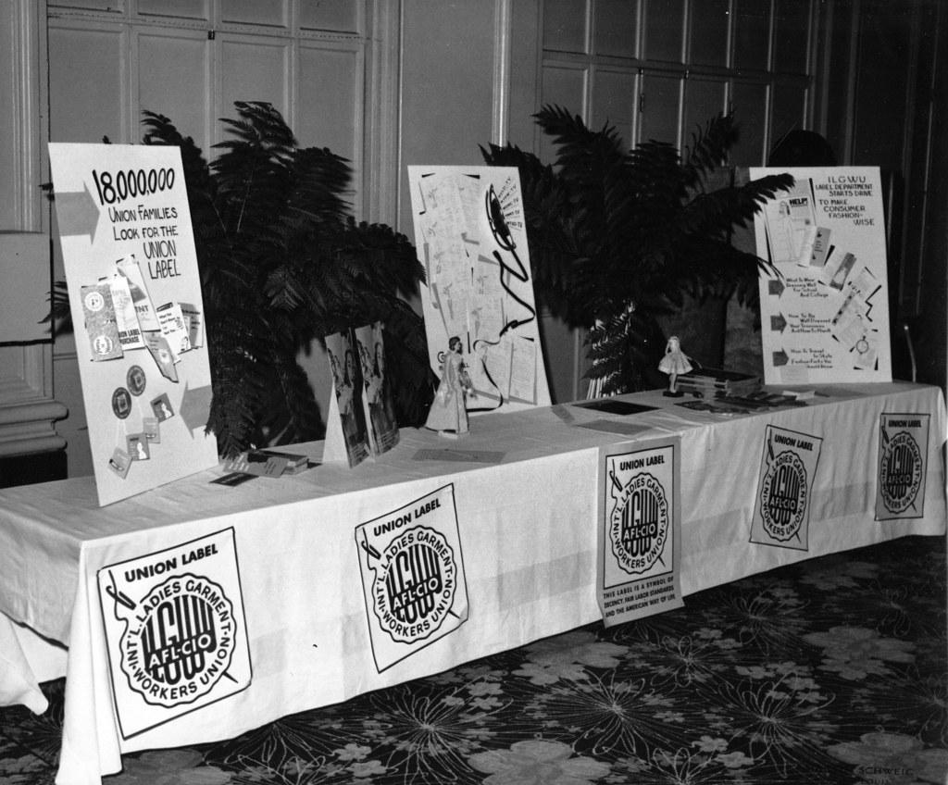










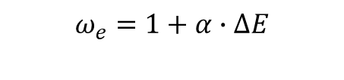
1
Image-Question Dataset
Candidate Responses
2
Visual Evidence Calibration
Candidate Generation
Decompose each response into visual claims(B example)
Evidence Score
$$E(y,I)$$
Evidence checking against image $I$
Response A
Claim 1: union-related evidence Union-related signs or logos are visible.
Image-Question
The image shows a union organization display.
Score
Response B
Claim 2: family-related evidence Text related to families is visible.
The image shows a Union Organization table setup with 18,000 families.
Supported
Claims
Average support of claims in response
Base MLLM
Response C
Claim 3: numerical claim The exact number ‘18,000 families’ is visually supported.
Supported
Prompt:
How many families?
The image does not provide any information about families.
Uncertain
Unsupported
3
Evidence-Calibrated Pair Construction
Chosen($y_{ω}$)
Rejected($y_{l}$)
Evidence Gap
Prompt:
How many families?
$$∆E=$$
$$E\left(y_{ω},I\right)−E(y_{l},I)$$
The image shows a Union Organization table setup with 18,000 families.
The image does not provide any information about families.
If > 0, indicates $y_{ω}$ is better
Evidence Gap
VEC-DPO
4
VEC-DPO Training
Chosen($y_{ω}$)
$$ℒ_{VEC−DPO}=ω_{e}∙ℒ_{DPO}$$
MLLM
Rejected($y_{l}$)
$$ω_{e}=1+α∙∆E$$
Training
Calibrated MLLM

